Slide 1
3. Morphological typology
ENG 452: Linguistic Typology

Slide 2
Introduction
Morphological typology is also a subfield of linguistics that studies the structural properties of languages.
Morphological typology is a method used by linguists to classify languages according to their morphological structure.
It’s a way to group languages by how they form words using morphemes.
We shall look into:
How words are formed: How morphemes combine to create words with different meanings
How morphemes modify meaning: How morphemes change the meaning of words through
derivation or inflection
How languages are classified: How languages are classified into types based on how they form words
Types of Morphological Linkage Between Constituents: between Head word and dependent
constituent

Slide 3
Morpheme
Morphemes are the building blocks of words in a language.
But what is a morpheme?
A morpheme is the smallest unit of language that has its own meaning,
A morpheme can be either a word by itself or a part of a word.
In a word such as uncovers, there are three morphemes: cover, which is the verbal root of the word, the prefix un-, and the suffix -s.
Each of these parts of the word contributes meaning to the whole.

Slide 4
Morphemes are of very different types
Some form the basis of words (such as cover), whereas others modify the meaning of this base in some way (such as un- and -s).

Slide 5
When morphemes are examined cross-linguistically, the variation becomes more dramatic.
It would be impossible to examine thousands of morphemes occur in languages around the world.
However, we find certain cross-linguistic regularities in the kinds of morphemes one encounters and patterns in the ways these morphemes are combined.

Slide 6
Bound vs Free Morphemes
A morpheme is said to be free if it can appear on its own without the presence of another morpheme.
In English, dog, the, and, walk, very, happy, and must are all examples of free morphemes,
whereas -s (as in dogs) and un- and -ed (as in un-cover-ed) are bound.
So, a morpheme is said to be bound morpheme if it cannot appear on its own as a word.

Slide 7
Compare these properties of the with the plural marker -s.
No words can separate -s from the noun it modifies, it cannot be stressed, and no pause can separate it from the nouns to which it is affixed.
For these reasons, it is clear that -s is a bound morpheme.

Slide 8
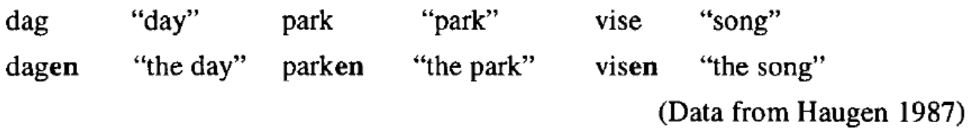
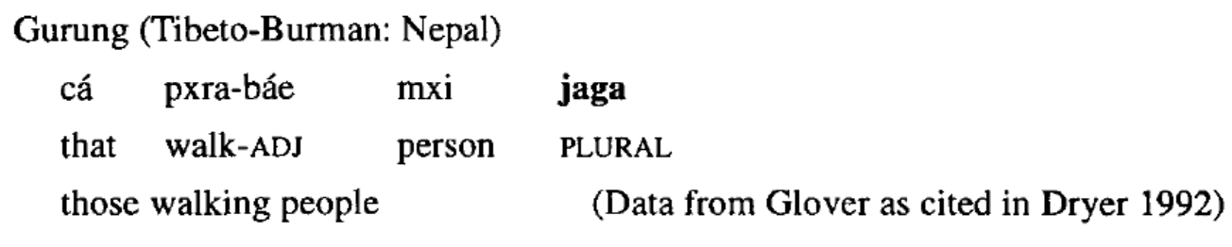
The determination of whether a morpheme is bound or free is also not fully derivable from its semantics.
Hence, in some languages, such as Danish (Germanic: Denmark), definiteness is marked by a bound morpheme rather than a free morpheme, such as the, in English..
Conversely, the marking of plurality is not always accomplished by affixation as it is in English. Instead, a separate plural word can be utilized as in the following:

Slide 9
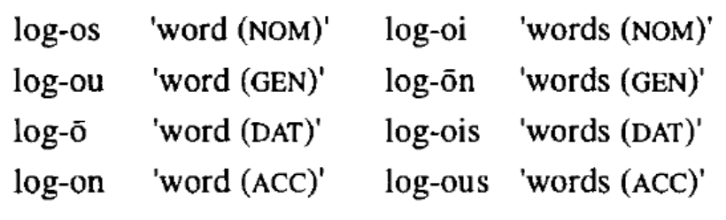
The notion of a free morpheme is often confused with the notion of a root, but the two terms are not equivalent because not all roots are free. In ancient Greek, for example, most noun roots must be considered bound because it is obligatory for them to occur with a case suffix.
Here, the noun root log- is clearly identifiable, but it never appears in a bare form.
Therefore, it is a bound morpheme

Slide 10
Prefixes and Suffixes
One way in which bound morphemes are classified is in terms of their formal relationship to roots.
The simplest relationship is affixation.
A bound form that is not itself a root and that is affixed to the front of a root is called a prefix (1).
A bound form that is affixed to the end of a root is called a suffix (2).
(1) in-adequate, re-use, pro-life
(2) pleas-ing, institut-ion-al-ize-s
More than one affix can occur on some roots. Though, usually, the order of these affixes is fixed.
Suffixation and prefixation are both widely attested in language, but there is a notable cross-linguistic preference for suffixes.

Slide 11
Derivational vs Inflectional Morphology

Slide 12
Derivational and Inflectional Morphemes
Bound morphemes can be divided into two types( derivational and inflectional morphemes)
Derivational Morphemes
These bound morphemes are used to make new words or to make words of a different grammatical category from the stem.
Derivational morphemes are those which change the part of speech or meaning when combined with a root. Generally the affixes used with the root word are bound morphemes.
derivational morpheme –ness changes the adjective good to the noun goodness.
Care can become careful or careless (by the addition of derivational morphemes -ful or – ness)
List of derivational morphemes will include suffixes like: -ish, - ly, and -ment.
Derivational morphemes also consist of prefixes such as; re-, pre-, ex-, mis-, co-, -un. (Yule, 2021)
Derivational morphemes are realized through prefixes as well as suffixes.

Slide 13
Inflectional Morphemes
Inflectional morphemes are not used to produce new words in the language
Are used to indicate aspects of the grammatical function of a word.
Inflectional morphemes are used to show weather a word (noun) is plural or singular, if it is past tense (for verbs), and if it is a comparative (adjectives) or possessive form (nouns), etc.
They take different forms depending on person, number, tense, etc.
There are eight inflectional morphemes or (inflections)
-s, -’s (nominal), -s, -ed, -ing, -ed, -en (verbal), -er, -est (adjectival).
Example:
Jim’s two sisters are really different.
One likes to have fun and is always laughing.
The other liked to read as a child and has always taken things seriously.
One is the loudest person in the house and the other is the quieter than a mouse. (Yule, 2021)

Slide 14
Class Changing and Class Maintaining morphemes (Prefix/suffix)
Class changing and class maintaining are the two kinds of derivational morphemes.
Class changing derivational morphemes
Class changing derivational morphemes are those that change the grammatical category (parts of speech) of the root after affixation.
Eg. the suffix ‘-able’ changes the class of the word ‘read’ from verb to adjective ‘readable’.
See more examples: -er, -ish, -al, teacher, boyish, national etc.

Slide 15
Class Maintaining Derivational Morphemes (Prefix/suffix)
Class-maintaining derivational morphemes(Prefix/suffix) are those that do not cause the change of grammatical class of the root after affixation.
Eg.
child (Noun) childhood (Noun)
king (Noun) kingdom (Noun)
Lion (Noun) Lioness (Noun)
Friend (Noun) Friendship (Noun)

Slide 16
Likewise, prefixation also results into class changing and class maintaining morphemes that can be seen through these examples.
Political (adj) | apolitical (adj) | Class maintaining prefixes
Metre (noun) | pentametre (noun)
Behave (verv) | misbehave (verb)
Sleep (verb) | asleep (adj) | Class changing prefixes
Grade (noun) | Degrade (verb)
Little (adj) | Belittle (verb)

Slide 17
The word establishments has three morphemes: the root establish and the two suffixes -merit and -s.
In the formation of the word establishments, the contribution of the two suffixes is quite different.
The suffix -ment transforms a verbal notion (establish) into a noun. In this way, it derives an entirely new concept. Instead of an action, establishment depicts an object. Accordingly, -ment is classified as a derivational morpheme.
In contrast, the suffix -s does not derive a new concept from establish. Rather, it indicates multiple instances of the same concept, and it is classified as an inflectional affix.

Slide 18
It is also common, however, to type languages (type of languages based on morphology) in terms of the dominant morphological strategies they employ because they can differ dramatically in this regard.

Slide 19
Languages based on Morphological typology
Morphology- the study of word formation and structure.
Morphological typology- a system for classifying the world’s languages based on how their morphemes are used.
Morphological typology is a way of classifying the languages of the world that groups languages according to their common morphological structures.
Linguists can categorize languages based on their word-building properties and usage of different affixation processes.
The broadest distinction among languages is whether or not affixation is allowed at all, or if every word must be a single morpheme.
Two main morphological types: analytic languages and synthetic languages.

Slide 20
Analytic and Isolating Languages
Analytic languages have sentences composed entirely of free morphemes, where each word consists of only one morpheme.
Isolating languages are “purely analytic” and allow no affixation (inflectional or derivational) at all.
However, it’s rare to find a language that is purely analytic or synthetic since most languages have characteristics of both.
Mandarin Chinese and Vietnamese are good examples of analytic languages. Note that properties such
as “plural” and “past” comprise their own morphemes and their own words.
[wɔ mən tan tçin lə] (Mandarin Chinese)
1st PLR play piano PST
‘We played the piano.’

Slide 21
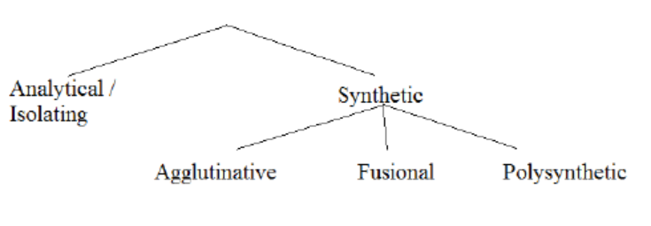
Synthetic Languages
Synthetic languages allow affixation such that words may (though are not required to) include two or more morphemes.
These languages have bound morphemes, meaning they must be attached to another word (whereas analytic languages only have free morphemes).
Synthetic languages include three subcategories: agglutinative, fusional, and polysynthetic.

Slide 22
Synthetic Language Type 1: Agglutinative
Agglutinative languages have words which may consist of more than one, and possibly many, morphemes.
Words are composed of multiple morphemes with clear boundaries.
With these languages, morphemes within words are usually clearly recognizable in a way that makes it easy to tell where the morpheme boundaries are.
Their affixes usually only have a single meaning.
Turkish, Korean, Hungarian, Japanese, and Finnish are all in this group. (agglutinative languages)

Slide 23
Examples of canonical agglutinative languages
el-ler-imiz-in (Turkish)
hand-plr.-1st plr.-genitive case, ‘of our hands’
ni-na-soma (Swahili)
I-present-read ‘I am reading’
(also u-na-soma ‘you read,’ ni-li-soma ‘I read,’ etc.)

Slide 24
Synthetic Language Type 2: Fusional
Fusional languages, like other synthetic languages, may have more than one morpheme per word.
Words are composed of multiple morphemes and blurred boundaries between them.
However, fusional languages may have morphemes that combine multiple pieces of grammatical information; that is, there is not a clear 1 to 1 relationship between grammatical information and morphemes
For example, in Spanish:
[ˈabl-o] ‘I am speaking’ -[o] suffix means 1st person sng., present tense
[ˈabl-a] ‘s/he is speaking’ -[a] suffix means 3rd person sng. present tense
[abl-ˈo] ‘s/he spoke’ -[ˈo] suffix with stress means 3rd singular past tense

Slide 25
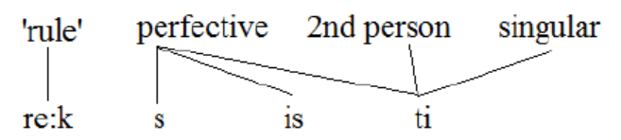
Latin fusion: [re:ksisti] ‘you all ruled’
There are four pieces of grammatical information and four morphs, however the ‘perfective’ meaning is shared among several morphs.

Slide 26
Synthetic Language Type 3: Polysynthetic
Polysynthetic languages often display a high degree of affixation (high number of morphemes per word) and fusion of morphemes, like agglutinative and fusional languages.
Words are composed of many morphemes, often with complex internal structures.
Additionally, however, polysynthetic languages may have words with multiple stems in a single word (which are not compounds). (Eg. Inuktitut)
This may be achieved by incorporating the subject and object nouns into complex verb forms.
For example:
anin- ɲam-jɔ-te-n (Munda: Sora)
he-catch-fish-nonpast-do ‘he is fish-catching’
This is called noun incorporation, where the object ‘fish’ is incorporated in the verb ‘catch.’

Slide 27
But in reality…
So we’ve looked at canonical examples of four types of languages:
analytical, agglutinative, fusional, and polysynthetic.
But languages often show elements of different morphological types.
If a language is hard to classify as one of the four main types, it may be considered “mixed.” The properties that distinguish these types may in fact be gradient rather than categorical.

Slide 28
What about Hindi ?????…
Hindi is considered a synthetic language rather than an analytic language.
Which means it uses inflectional suffixes to indicate grammatical relationships between words.
Regarding its inflectional system, Hindi is considered a fusional language, which means that one suffix can represent multiple grammatical meanings.
While Hindi does show some agglutinative characteristics in its morphology, it is generally classified as a fusional language rather than an analytic one, meaning it primarily relies on inflectional morphemes that can combine multiple grammatical functions within a single word, not separate, easily identifiable morphemes like in a truly agglutinative language; therefore, the statement "Hindi is not analytic but syntax and agglutinative language" is mostly accurate, although it should be noted that Hindi does not fully fit into the "agglutinative" category either.
Typologically, Hindi is an in flexional analytic languages as well as agglutinative and isolating language.

Slide 29
Types of Morphological Linkage Between Constituents
1. Government Versus Agreement
In the following ancient Greek data, the choice of which case suffix is used on a noun is determined by the preposition (which is in bold type):
(1) a. ana skē:ptr-ō: (DAT) “upon a staff”
b. apo tou hipp-ou (GEN) “from a horse”
c. en Spart-ē (DAT) “in Sparta”
d. eis basil-ea (ACC) “to the king”
Notice that the prepositions carry no special morphology. They are monomorphemic and fixed in form regardless of the noun that follows them. This is a classic case of government, in which the syntactic relationship between two constituents is captured by obligatory marking on the dependent constituent.
the preposition is said to “govern” a particular case—for example, ana (“up”) governs dative case

Slide 30
A different situation arises in the Spanish (Italic: Latin America and Spain) data in the following:
(2) a. la elefanta negr-a “the black elephant”
b. las elefantas negr-as “the black elephants”
c. el gato negr-o “the black cat”
d. los gatos negr-os “the black cats”
Unlike (1), the syntactically dependent constituents in (2) are placed in a form that corresponds to that of the head noun so that all three are in agreement.
In (2a), the noun elefanta ("elephant") is feminine singular.
Consequently, the feminine singular article la must be used, and the adjective must be formed with the
feminine singular suffix -a.

Slide 31
2. Head Versus Dependent Marking
The notions of government and agreement are used in describing the nature of the morphological connection between constituents.
If the morphological marking of a dependent is determined by a head, but does not reflect any semantic or grammatical features of the head, it is considered government (as in the Greek example in (1) above).
If the morphological marking does reflect such properties, it is a case of agreement (as in the Spanish example in (2) above).

Slide 32
These notions, however, do not easily permit linguists to describe differences in the location of morphological marking that arise among languages even in functionally analogous constructions.
For example, consider the following:
(3) a. a man’s house (possessor marked) English
b. az ember h’az-a (possessee marked) Hungarian (Finno-Ugric: Hungary)
the man house-3S
For these two possessive constructions, the terminology that has been introduced so far is not well suited to capture the relevant distinction between the English pattern (3a) and the Hungarian (Finno-Ugric: Hungary) pattern (3b).
In terms of syntactic relations, these two examples are identical—a head noun is being modified by a possessor.

Slide 33
One might describe (3a) as an instance of government because the dependent takes the genitive
marker –s due to its relationship with the head noun.
In (3b), however, it is not the possessor that is marked but the possessee.
Because the dependent is not marked, the construction in (3b) is not an instance of government or
agreement as these terms were defined previously.
Because the possessee is the head of the noun phrase, we say that Hungarian displays head marking, whereas English displays dependent marking

Slide 34
The syntactic relation that holds between head and nonhead in these constructions is not always indicated morphologically.
In Kobon (Trans-New Guinea: New Guinea), simply juxtaposing possessor and possessee (4) can create genitive constructions that are semantically comparable to the English and Hungarian discussed previously.
(4) Dumnab ram
Dumnab house
‘Dumnab’s house’

Slide 35
More exceptionally, marking may occur both on the head and on the dependent simultaneously.
This phenomenon, called double-marking, is exemplified by the following Turkish possessive phrase:
(5) ev-in kapi-si
house-GEN door-3S
‘the door of the house’
In this example, a genitive marker is affixed to the possessor noun ev ("house"), and an agreement suffix is found on the head noun kapi ("door").
Both morphemes are necessary to form the construction properly.

Slide 36
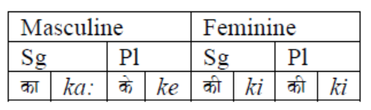
Let’s see Hindi example
The Postposition ka
The postposition ka: is used to denote the relationship between a noun or pronoun and another noun that follows it.
It is used to denote possession and relationship, material or composition, worth and measure, source, origin, cause, subject or object of an act, part of a whole, purpose or characteristics or trait.
The form of this postposition agrees with the gender and number of the noun as follows.

Slide 37
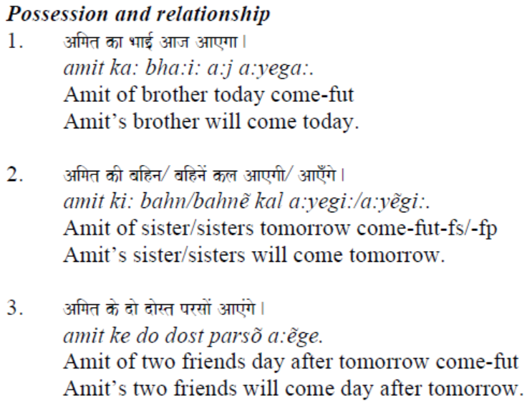
Hindi

Slide 38
Implications for Universals
Using a database of 60 languages, Nichols (1986) discovered that languages fall into the following four major types:
1. Head marking—the predominate strategy of indicating dependency is to mark the head
(e.g., Blackfoot and Lakhota).
2. Dependent marking—the predominate strategy of indicating dependency is to mark the dependent
(e.g., Greek).
3. Double marking—a significant number of constructions mark both head and dependent, thereby
making it impractical to place the language in the headmarking or dependent-marking categories
(e.g., Aleut and Arabic).
4. Split marking—they display roughly equivalent numbers of head-marking and dependent-marking
patterns (e.g., Bantu languages, in which the clause level is head marked and the phrase level is
dependent marked).
(Note: Languages of the first three types are probably never entirely consistent.
The four categories listed above represent tendencies and not discrete sets. )

Slide 39
Some of the most extreme examples come from Eskimo languages such as West Greenlandic:
tusaa-nngit-su-usaar-tuaannar-sinnaa-nngi-vip-putit
hear’-neg.-intrans.participle-‘pretend’-‘all the time’-‘can’-neg.-
‘really’-2nd.sng.indicative
‘You simply cannot pretend not to be hearing all the time’

Slide 40
References
Whaley, Lindsay J. 1996. Introduction to typology: the unity and diversity of language. London: Sage.
Morphology: Key Concepts
https://www.researchgate.net/profile/Abdel-Rahman-Altakhaineh/publication/342523154_Morphology_Key_Concepts/links/5ef9d441a6fdcc4ca43a31bc/Morphology-Key-Concepts.pdf
https://www.academia.edu/39514954/Morphological_Typology_Ling_100_Introduction_to_Linguistic_Science

